Slide 1

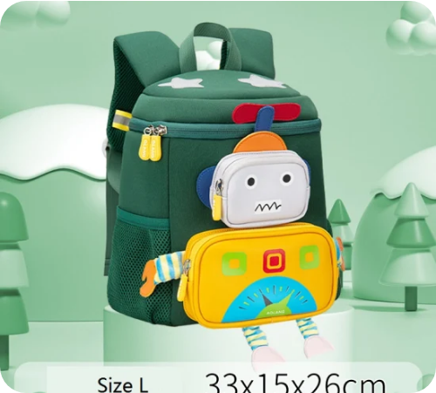

AI in Everyday Life
Hi there! 👋
You might think Artificial Intelligence (AI) is just for sci-fi movies, but it's actually all around us!
Think of AI as a super-smart helper that learns from what you do to help you better.
It's closer than you think! Let's see where it hides.

Slide 2

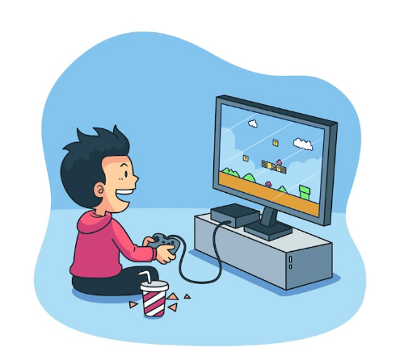

Fun & Games 🎮
Ever wonder how YouTube or Netflix always knows exactly what video you want to watch next?
That's AI Recommendation! It looks at what you liked before and finds similar things.
How does YouTube know you like funny cat videos?

Slide 3

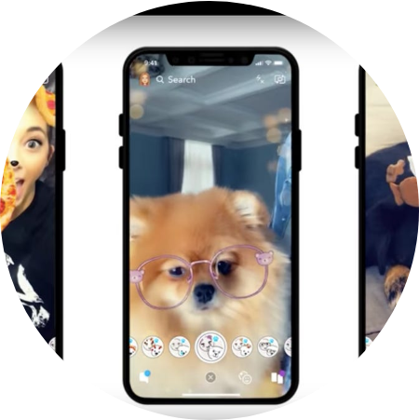

Filters & Photos 📸
Do you use funny face filters on Snapchat or TikTok? That's AI computer vision!
The AI can "see" your face and knows exactly where your eyes, nose, and mouth are to put on those dog ears.
Raise your hand if you used a filter today!

Slide 4








Smart Helpers 🤖
Voice Assistants
Navigation
Your Turn!
Siri & Alexa listen to your voice and use AI to understand your questions.
Google Maps uses AI to check traffic and find the fastest route.
What is the weirdest thing you ever asked Alexa or Siri?

Slide 5

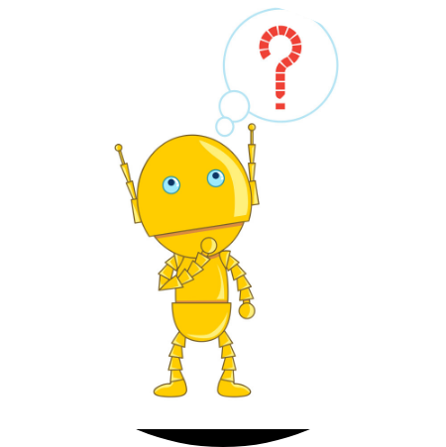
Friend or Tool? 🤔
Let's Recap:
•
AI is everywhere (Games, Phones, Maps).
•
It learns from us to be helpful.
•
It's a tool to make life easier.
Reflection: If you could build an AI robot, what would it do?

